Slide 1

ITA0404 – STATISTICS WITH R PROGRAMMING
A Comprehensive Analysis of E-Commerce Product Sales Using R Programming
Presented By
THIRULOGASUNDAR Y – (192321073)
YARRAPUREDDY LAKSHMI REDDY -- (192321077)
RUPESH REDDY KARNATI – (192324097)
R RAJIV SASANK – (192321042)
Supervisor
Dr. KUMARESAN G

Slide 2
Project Overview
Description
This project analyzes e-commerce sales data using R Programming to uncover business insights through statistical analysis and visualization. The project focuses on identifying sales trends, product performance, customer purchasing behavior, and regional sales patterns to support data-driven decision-making.
Key Features
Data Cleaning and Preprocessing
Exploratory Data Analysis (EDA)
Sales Trend Analysis
Interactive Data Visualization

Slide 3

Reference Study
Dataset
Sample Superstore / E-Commerce Sales Dataset
Analysis Performed
Product-wise Sales
Category Analysis
Region-wise Performance
Profit Analysis
Customer Segment Analysis
Tools
R Programming
RStudio

Slide 4

OBJECTIVES
Analyze overall sales performance.
Identify best-selling products.
Compare category-wise sales.
Evaluate regional performance.
Visualize sales trends.
Generate business insights using statistical techniques.

Slide 5
Proposed Module Breakdown
Module | Responsibility | R Package
Data Collection & Preprocessing | Import, clean, and transform sales data | readr, dplyr
Exploratory Data Analysis | Analyze sales, profit, categories, regions | dplyr
Data Visualization | Create charts and dashboards | ggplot2
Business Insights & Reporting | Generate reports and recommendations | R Markdown, dplyr

Slide 6
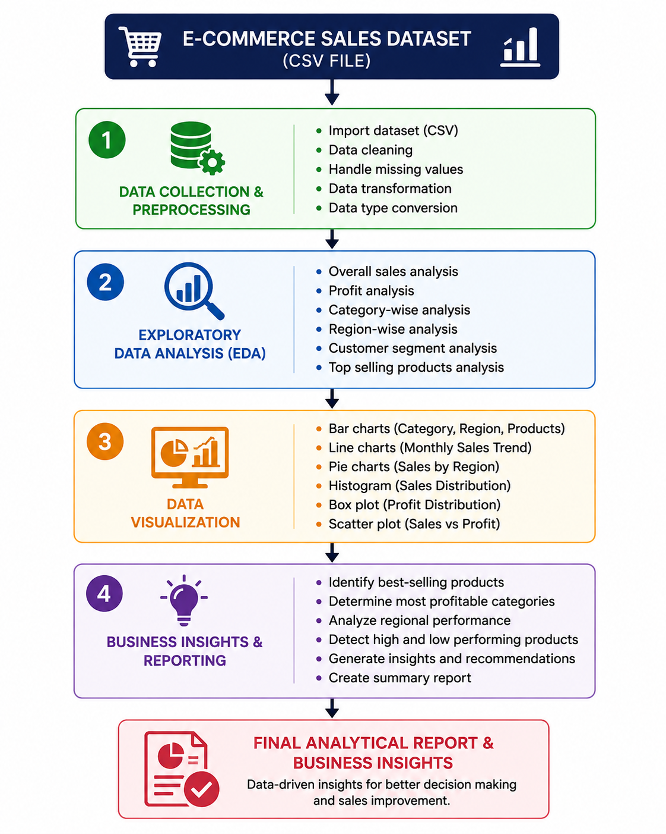
Flow Chart

Slide 7
Technology Stack
Technology | Purpose
R Programming | Data Analysis
RStudio | Development Environment
dplyr | Data Manipulation
ggplot2 | Data Visualization
tidyverse | Data Wrangling
R Markdown | Report Generation
CSV Dataset | Data Source

Slide 8
Dataset Structure
Column | Description
Order ID | Unique Order Identifier
Order Date | Purchase Date
Product Name | Product Details
Category | Product Category
Sales | Total Sales Amount
Profit | Profit Earned
Quantity | Units Sold
Region | Sales Region
Customer Segment | Customer Type

Slide 9
Proposed Analysis
Total Sales Analysis
Monthly Sales Trend
Product Performance Analysis
Category-wise Sales
Region-wise Sales
Profit Analysis
Top 10 Products
Customer Segment Analysis

Slide 10
Expected Visualizations
Bar Chart (Category-wise Sales)
Line Chart (Monthly Sales Trend)
Pie Chart (Sales by Region)
Histogram (Sales Distribution)
Box Plot (Profit Distribution)
Scatter Plot (Sales vs Profit)

Slide 11
Work Plan / Timeline
Week 1
Dataset Collection
Data Cleaning
Week 2
Exploratory Data Analysis
Statistical Analysis
Week 3
Data Visualization
Business Insights
Week 4
Report Preparation
Final Presentation

Slide 12
Anticipated Challenges
Challenge 1
Handling missing or inconsistent data.
Solution
Perform data cleaning and preprocessing.
Challenge 2
Visualizing large datasets effectively.
Solution
Use optimized charts with ggplot2.
Challenge 3
Extracting meaningful business insights.
Solution
Apply statistical summaries and comparative analysis.

Slide 13
THANK YOU

